Slide 1
Introduction to Artificial Intelligence
Greg Grudic
Modified by Longin Jan Latecki
Introduction to AI

Slide 2
Goal of the Course
A fundamental understanding of the basic concepts behind Artificial Intelligence
  What does it mean for a machine to exhibit AI?
A practical understanding of how to apply AI to real world problems
PLEASE ASK QUESTIONS!!!
Introduction to AI

Slide 3
What is an AI System?
Sensing
Agent
World
Computation
Action
Introduction to AI

Slide 4
Components of an AI System
World
  This is where the AI agent lives
Agent
  Sensing: Takes information from the world
  Computation: Makes computations based on what it has sensed (perhaps using a time history of senor readings)
  Action: Acts in the world to change the state of the agent within it (towards some purpose).
Introduction to AI

Slide 5
What are some common uses (successes) of AI Systems?
Web search: google, ask, yahoo….
Loan Applications
Marketing
Economic Analysis
  Stocks to buy….
  Products to produce…
  Prices to charge….
  Federal economic policies…
Computer Games
Criminology
Introduction to AI

Slide 6
AI System
Agent
Sensing
data received from
the world
Plan actions based on
sensor observations and
the results of previous
actions
World
Computation
physical world
  robotics
Internet
Computer program
  game
Action
“Move” the agent to some new state in the worlds
Introduction to AI

Slide 7
Some AI Systems that are Better Than Humans (1)
Checkers
  Chinook was the first computer program to win a checkers world championship (using heuristics)
    http://www.cs.ualberta.ca/~chinook/
  Checkers is now solved
    http://www.cs.ualberta.ca/~chinook/publications/solving_checkers.html
    There is a proof that nothing can now beat this program (no more heuristics)
Introduction to AI

Slide 8
Some AI Systems that are Better Than Humans (2)
Chess
  DEEP BLUE was the first computer program to beat the world chess champion (using powerful computers and a bunch of very good heuristics)
    http://en.wikipedia.org/wiki/IBM_Deep_Blue
  Not yet solved…
Introduction to AI

Slide 9
Some AI Systems that are Better Than Humans (3)
Backgammon
  TD gammon was the first program to beat the worlds best players (Gerald Tesauro)
    http://researchweb.watson.ibm.com/massive/tdl.html
Introduction to AI

Slide 10
Some AI Systems that are Better Than Humans (4)
Robotics for manufacturing in structured factories
  Many products (cars, computers, etc..) are made using robots
Introduction to AI

Slide 11
Some Failures of AI
The game GO
  Simple rules but very large search space…
Expert systems (in general)
  These attempted to encode an experts knowledge into an autonomous reasoning systems
Robotics in unstructured environments. A robot cannot
  Clean my house
  Cook when I don’t want to
  Wash my clothes
  Cut my grass
  Fix my car (or take it to be fixed)
  i.e. do the things that I don’t feel like doing…
Introduction to AI

Slide 12
Robotics
Robotics is AI in the physical world
It is the hardest subfield of AI because robots must sense and act in the physical world
The computer revolution has changed the world….
However, the robotics revolution, when it happens, will make the computer revolution pale in comparison
Introduction to AI

Slide 13
A Open Problem in AI/Robotics?
“Vision-based autonomous navigation in unstructured outdoor environments”
The problem of navigating between 2 GPS waypoints (more than a few hundred metres apart) in unstructured outdoor environments is unsolved!
Introduction to AI

Slide 14
What About the DARPA Grand Challenge 2005?
Autonomous Navigation in the Desert over a 132 mile course.
5 Teams succeeded!
  http://www.darpa.mil/grandchallenge05/gcorg/index.html
This was a monumental achievement in autonomous robotics
HOWEVER: This was not an unstructured environment!
  GPS waypoints were carefully chosen, sometimes less than a meter apart.
Greg Grudic
Introduction to AI

Slide 15

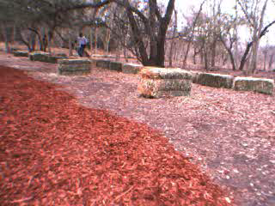

Environments that DARPA Grand Challenge winners would find challenging:
Greg Grudic
Introduction to AI

Slide 16
What is AI?
Views of AI fall into four categories:
Thinking humanly Thinking rationally
Acting humanly Acting rationally
Warning, I advocate for “acting rationally” based on Machine Learning
  but I am willing to hear other arguments and change my mind
Greg Grudic
Introduction to AI

Slide 17

Acting humanly: Turing Test
Turing (1950) "Computing machinery and intelligence":
"Can machines think?" → "Can machines behave intelligently?"
Operational test for intelligent behavior: the Imitation Game
Predicted that by 2000, a machine might have a 30% chance of fooling a lay person for 5 minutes
Anticipated all major arguments against AI in following 50 years
Suggested major components of AI: knowledge, reasoning, language understanding, learning
Greg Grudic
Introduction to AI

Slide 18
Thinking humanly: cognitive modeling
1960s "cognitive revolution": information-processing psychology
Requires scientific theories of internal activities of the brain
  How to validate? Requires
  1) Predicting and testing behavior of human subjects (top-down), or
  2) Direct identification from neurological data (bottom-up)
Both approaches (roughly, Cognitive Science and Cognitive Neuroscience) are now distinct from AI
Greg Grudic
Introduction to AI

Slide 19
Thinking rationally: "laws of thought"
Aristotle: what are correct arguments/thought processes?
Several Greek schools developed various forms of logic: notation and rules of derivation for thoughts; may or may not have proceeded to the idea of mechanization
Direct line through mathematics and philosophy to modern AI
Problems:
  Not all intelligent behavior is mediated by logical deliberation
  What is the purpose of thinking? What thoughts should I have?
  Should thinking need to be associated with actions?
Greg Grudic
Introduction to AI

Slide 20
Acting rationally: rational agent
Rational behavior: doing the right thing
The right thing: that which is expected to maximize goal achievement, given the available information
  Problem: How do we know the agent is doing this?
Doesn't necessarily involve thinking – e.g., blinking reflex – but thinking should be in the service of rational action
Greg Grudic
Introduction to AI

Slide 21
Rational agents
An agent is an entity that perceives and acts
This course is about designing rational agents
Abstractly, an agent is a function from percept histories to actions:
[f: P* → A]
For any given class of environments and tasks, we seek the agent (or class of agents) with the best performance
Caveats:
  computational limitations make perfect rationality unachievable
    design best program for given machine resource
  Can we ever know if an agent is acting rationally?
Greg Grudic
Introduction to AI

Slide 22
AI prehistory
Philosophy: Logic, methods of reasoning, mind as physical
system, foundations of learning, language,
rationality
Mathematics: Formal representation and proof algorithms,
computation, (un)decidability, (in)tractability,
probability
Economics: Utility, decision theory
Neuroscience: physical substrate for mental activity
Psychology : Phenomena of perception and motor control,
experimental techniques
Computer Building fast computers (fast enough?)
Engineering:
Control theory: Design systems that maximize an objective
function over time.
Linguistics: Knowledge representation, grammar
Greg Grudic
Introduction to AI

Slide 23
Abridged history of AI
1943 McCulloch & Pitts: Boolean circuit model of brain
1950 Turing's "Computing Machinery and Intelligence"
1956 Dartmouth meeting: "Artificial Intelligence" adopted
1952—69 Great enthusiasm for AI!
1950s Early AI programs, including Samuel's checkers
program, Newell & Simon's Logic Theorist,
Gelernter's Geometry Engine
1965 Robinson's complete algorithm for logical reasoning
1966—73 AI discovers computational complexity
Neural network research almost disappears
1969—79 Early development of knowledge-based systems
1980-- AI becomes an industry
1986-- Neural networks (Machine Learning) return to popularity
1990-- Machine Learning, Statistics and Mathematics join forces
1987-- AI becomes a science
1995-- The emergence of intelligent agents
Greg Grudic
Introduction to AI

Slide 24
Some state of the art AI
Deep Blue defeated the reigning world chess champion Garry Kasparov in 1997
Proved a mathematical conjecture (Robbins conjecture) unsolved for decades
No hands across America (driving autonomously 98% of the time from Pittsburgh to San Diego)
During the 1991 Gulf War, US forces deployed an AI logistics planning and scheduling program that involved up to 50,000 vehicles, cargo, and people
NASA's on-board autonomous planning program controlled the scheduling of operations for a spacecraft
Proverb solves crossword puzzles better than most humans
Greg Grudic
Introduction to AI

Slide 25
Personal View of AI by Greg Grudic
I want to build a robot that will
  Clean my house
  Cook when I don’t want to
  Wash my clothes
  Cut my grass
  Fix my car (or take it to be fixed)
  i.e. do the things that I don’t feel like doing…
Therefore: AI is (to me) the science of building machines (agents) that act rationally with respect to a goal.
Greg Grudic
Introduction to AI

Slide 26
Agent: sensing, computation, and action
Agent
Sensing
data received from
the world
Plan actions based on
sensor observations and
the results of previous
actions
World
Computation
physical world
  robotics
Internet
Computer program
  game
Action
“Move” the agent to some new state in the worlds
Greg Grudic
Introduction to AI

Slide 27
What is a Rational Agent?
An agent is an entity that senses, computes and acts in some world
A rational agent is one that does the right thing
  The right thing: that which is expected to maximize goal achievement (accomplishing tasks that Greg doesn’t feel like doing), given the available information
This is not a new idea:
  Aristotle (Nicomachean Ethics): Every art and every inquiry, and similarly every action and pursuit, is thought to aim at some good
Greg Grudic
Introduction to AI

Slide 28
Elements of AI
Representation
Reasoning
Learning
Greg Grudic
Introduction to AI

Slide 29
(My) Elements of AI
Representation
Reasoning
Learning
Greg Grudic
Introduction to AI

Slide 30
Why Must Representation and Reasoning be Encompassed by Learning?
Fundamental lesson of AI (learned in the 1980’s):
  It is not possible to hand code knowledge about anything but the most trivial problem domains!
    Uncertainty is a key problem!
  Expert Systems: largely failed because an expert (e.g. doctor) doesn’t know how to formalize (code) what makes her an expert!
  For Example: I’m an expert on chairs but I can’t (and no one can!) write a program that identifies chairs in an image
    However, using ML techniques we are closer to this goal!
How can I reason rationally about a world I cannot encode knowledge about?
I do not believe that an agent can gain knowledge about a world without sampling it and learning from those samples….
Greg Grudic
Introduction to AI

Slide 31
AI Agent: A Different Perspective
Signals
world
Sensing
Actions
Uncertainty
Computation
Not typically
addressed in CS
Symbols
State
(The
Grounding
Problem)
Decisions/Planning
Agent
Greg Grudic
Introduction to AI

Slide 32
Why is Machine Learning Important?
Machine Learning is a Principled Methodology for dealing with uncertainty (noise) in
  world
  sensors
  computation
  action
Greg Grudic
Introduction to AI

Slide 33
Where can Machine Learning Algorithms be Found?
Marketing
  Who should a company target for advertising?
Profiling
  Is passenger 57 likely to hijack the plane?
User interfaces
  Making it easier to interact with a PC by anticipating what I am doing.
Document characterization
  Searching the web for things of interest.
Bioinformatics
  Human genome project
    Which gene is responsible for the cancer that runs in my family?
Data mining
  “Data doubles every year”, Dunham 2002
  ML algorithms are used to make sense of this data
Economics, medical diagnosis, robotics, computer vision, manufacturing, inventory control, elevator operation….
Greg Grudic
Introduction to AI

Slide 34
What is Machine Learning?
“The goal of machine learning is to build computer systems that can adapt and learn from their experience.”
  Tom Dietterich
What does this mean?
When are ML algorithms NOT needed?
Greg Grudic
Introduction to AI

Slide 35

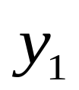

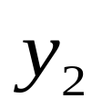
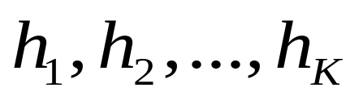
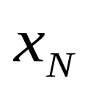
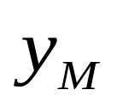
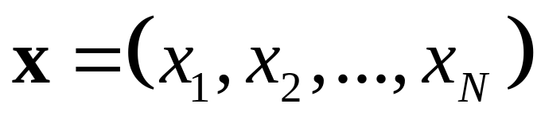
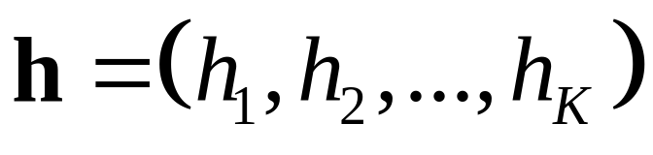
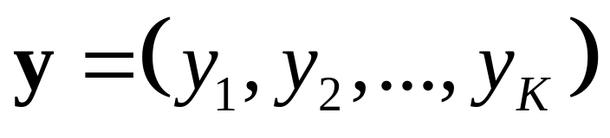
A Generic System (Agent?)
System
…
…
Input Variables:
Hidden Variables:
Output Variables:
Greg Grudic
Introduction to AI

Slide 36
Another Definition of Machine Learning
Machine Learning algorithms discover the relationships between the variables of a system (input, output and hidden) from direct samples of the system
These algorithms originate form many fields:
  Statistics, mathematics, theoretical computer science, physics, neuroscience, etc
Greg Grudic
Introduction to AI

Slide 37
When are ML algorithms NOT needed?
When the relationships between all relevant system variables (input, output, and hidden) is adequately understood!
This is NOT the case for many complex real systems!
Greg Grudic
Introduction to AI

Slide 38
Main Subfields of Machine Learning
Supervised learning
  Classification
  Regression
Semi-Supervised (Transduction) learning
Active learning
Reinforcement Learning
Unsupervised Learning
Greg Grudic
Introduction to AI

Slide 39





Learning Classification Models
Collect Training data
Build Model: happy = f(feature space)
Make a prediction
High
Dimensional
Feature
Space
Greg Grudic
Introduction to AI

Slide 40
Learning Regression Models
Collect Training data
Build Model: stock value = f(feature space)
Make a prediction
*
*
*
*
*
*
*
*
*
*
*
*
*
*
*
*
*
*
*
*
*
*
Stock
Value
*
*
*
*
*
*
*
*
*
*
*
*
*
*
*
*
*
*
*
Feature Space
Greg Grudic
Introduction to AI

Slide 41
Search
AI can be thought of as
  Specification of a GOAL
    Optimization criteria…
  Method for searching action and sensor space to achieve the goal
Two types of searches
  Symbolic (logic, reasoning, etc)
  Numeric – establish a continuous search space (topology)
Search in the real world is hard….
  Efficient solutions require constraints in search space
Machine Learning is one framework for efficiently constraining search…
Greg Grudic
Introduction to AI

Slide 42
Planning
Start with an assumed structure in the problem space
  e.g. robot in a Cartesian World (3-D map) wants to get to a GPS goal position from some start GPS position
Structure is used to plan a sequence of actions from some initial state to a goal state.
Goal
Obstacle
Robot
Static
Navigational
Feature
Greg Grudic
Introduction to AI

Slide 43
Optimal Decision Theory
Acting under uncertainty
  Measuring uncertainty in complex environments is the domain of Machine Learning
Given all the available information, what is the optimal decision (or action) that the agent should take?
Greg Grudic
Introduction to AI

Slide 44
Computer Vision
The camera is our best sensor for physical human environments…
  Humans are extremely good at interpreting the world visually
  AI systems that work in the human physical world need to utilize visual data
Computer vision uses realistic constraints and knowledge of camera geometry to infer knowledge about the world from 2D images
Greg Grudic
Introduction to AI

Slide 45
Robotics
Robotics is AI in the physical world
It is the hardest subfield of AI because robots must sense and act in the (uncertain) physical world
  AI inside a computer (internet) is much more constrained
The computer revolution has changed the world….
However, the robotics revolution, when it happens, will make the computer revolution pale in comparison
Greg Grudic
Introduction to AI

Slide 46
The main challenge in robotics:
Visual perception
Visual perception is the ability to interpret the surrounding environment by processing information that is contained in visible light.
The machinery that accomplishes these tasks is by far the most powerful and complex of the sensory systems. The retina, which contains 150 million light-sensitive rod and cone cells, is actually an outgrowth of the brain. In the brain itself, neurons devoted to visual processing number in the hundreds of millions and take up about 30% of the cortex, as compared with 8% for touch and just 3% for hearing.
Greg Grudic
Introduction to AI

Slide 47
Human Visual Processing
The optic nerves convey signals from the retinas first to two structures called the lateral geniculate bodies, which reside in the thalamus, a part of the brain that functions as a relay station for sensory messages arriving from all parts of the body. From there the signals proceed to a region of the brain at the back of the skull, the primary visual cortex, also known as V1. They then feed into a second processing area, called V2, and branch out to a series of other, higher centers-- dozens, perhaps--with each one carrying out a specialized function, such as detecting color, detail, depth, movement, or shape or recognizing faces.
But how do we make sense out of the visual data?
Greg Grudic
Introduction to AI

Slide 48

Slide by Zygmunt Pizlo
What do you see?

Slide 49
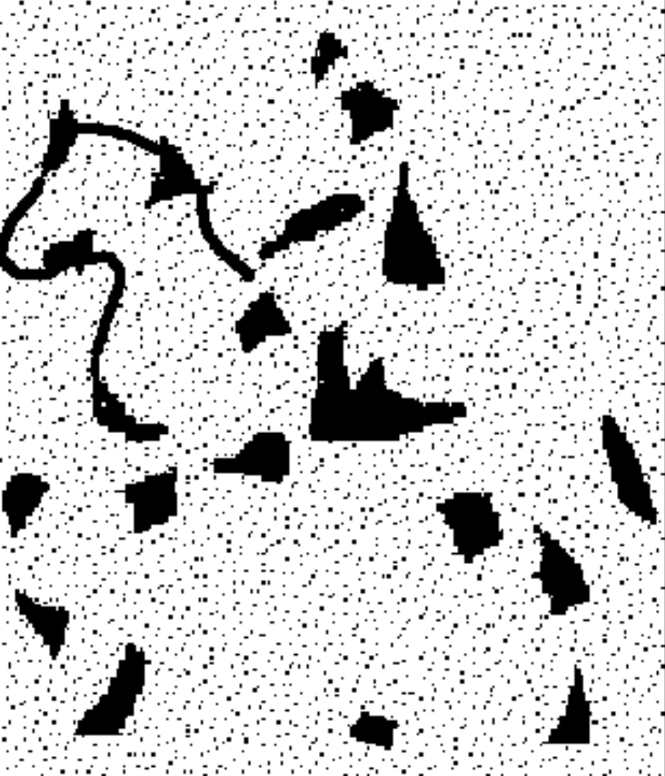
With grouping constraints we can see (i.e., recognize the object).

Slide 50
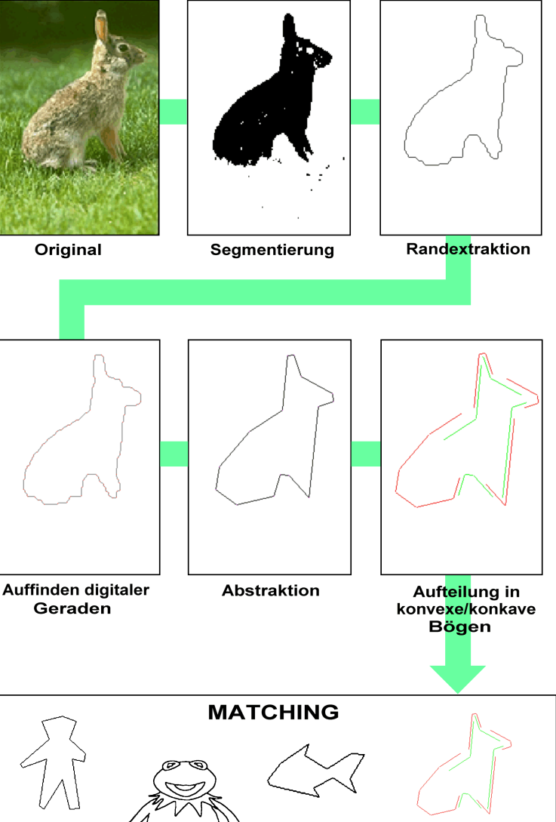
Object Recognition Process:
Source:
2D image of a 3D object
Object Segmentation
Contour Extraction
Contour Cleaning, e.g., Evolution
Contour Segmentation
Matching: Correspondence of Visual Parts
Slide by Rolf Lakaemper

